Slide 1
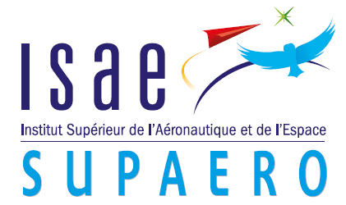
Avoid aeroelasticity instabilities with a morphing airfoil by reinforcement learning
Raul CARREIRA RUFATO
Tutor Dr Joseph Morlier

Slide 2
Introduction
Aeroelastic instabilities
Morphing airfoils
Objective: avoid flutter, LCO and divergency
Approach: reinforcement learning

Slide 3
Introduction
References
[1] Reinforcement Learning of Morphing Airfoils with Aerodynamic and Structural Eﬀects; Amanda Lampton,
Adam Niksch and John Valasek; AIAA 2007, Rohnert Park, California.
[2] Evaluating the impact of morphing technologies on aircraft performance; Jason Bowman, Major Brian
Sanders, Dr. Terrence Weisshaar; 43rd AIAA/ASME/ASCE/AHS/ASC 2002, Denver, Colorado
[3] Fundamentals of Aerodynamics; John D. Anderson, Jr.; McGraw-Hill Book Company, 1984
[4] Fluid-Structure Interactions: Volume 2; Paidoussis, Michael P.; Elsevier Science, 2016
[5] J. S. Gray, J. T. Hwang, J. R. R. A. Martins, K. T. Moore, and B. A. Naylor, “OpenMDAO: An Open-Source
Framework for Multidisciplinary Design, Analysis, and Optimization,” Structural and Multidisciplinary
Optimization, 2019.

Slide 4
Subject
Module
Aerodynamics
Structure
Flight conditions
Hypothesis
Incompressible flow
2D
Quasi-static aerodyn
Inviscid flow
Hypothesis
Linear deformations
2D
Quase-static
2 modes aproximation
Start
Interface
Loads to structural mesh
Aero Loads
Velocities & Displacements to fluid mesh
Calculus
Transfer loads between meshes
Verify aeroelastic instablities
Morphing airfoil shape (variation in chord and thickness)
Struct Velocities & Displacements

Slide 5
Subject
Big picture
Module
Flight conditions
[1] Reinforcement Learning of Morphing Airfoils
with Aerodynamic and Structural Eﬀects;
Amanda Lampton, Adam Niksch and John
Valasek; AIAA 2007, Rohnert Park, California.
Start
Aerodynamics
Structure
[1], [2],[3]
[3]
[2] Fundamentals of Aerodynamics; John D.
Anderson, Jr.; McGraw-Hill B. Company, 1984
[3] J. S. Gray, J. T. Hwang, J. R. R. A. Martins, K. T.
Moore, and B. A. Naylor, “OpenMDAO: An
Open-Source Framework for Multidisciplinary
Design, Analysis, and Optimization,” Structural
and Multidisciplinary Optimization, 2019.
Interface
New airfoil
[1],[3],[4],[5]
[4] Fluid-Structure Interactions: Volume 2;
Paidoussis, Michael P.; Elsevier Science, 2016
Optimum airfoil for flight conditions
Convergence?
No
Yes
[5] Reinforcement Learning: An Introduction,
Richard S. Sutton and Andrew G. Barto;
The MIT Press Cambridge, 2 edition, 2018

Slide 6
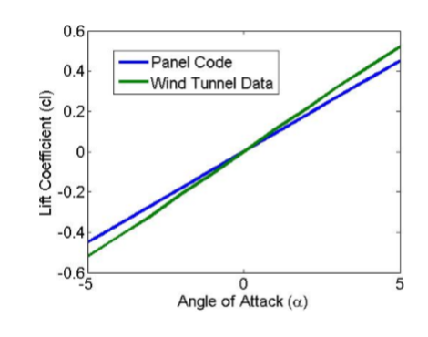
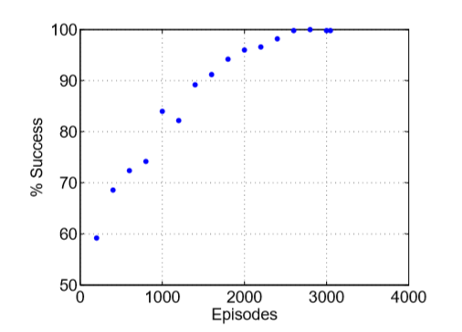
Methodology
Validation of th aerodynamic model for an airfoil [1]
Develop aerodynamics and structure modules based on and [1];
Build a learning database for aeroelasticity (changing geometric parameters);
Add the wingbox in the Airfoil;
Change the airfoil parameter & the wingbox parameters to build a learning database;
Implement reinforcement learning method.
Reinforcement learning succes [1]

Slide 7
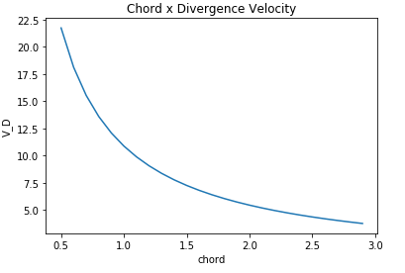
Current work
Aerodynamics and structure modules
Building database changing geometrical parameters;

Slide 8
Conclusions
Final thoughts and future work
Future work
Finish the aeroelastic model
Implement reinforcement learning method to avoid aeroelastic instabilities (the simplest ones)
Expect everything right!!
Distant future: 3D approach and highly flexible wings
Simplified model
Great applicability
More complex than expected

Slide 9
Conclusions
Thank you for your attention!
Questions??

